Slide 1
CIS 276: Introduction to Enterprise Web Development
transitionalDTD.txt
widgets1.html
parag.txt
universal.txt
order.txt
tours.txt
exercise1

Slide 2
Learning Outcomes
This presentation will...
Describe HTML
Use the HTML, head, title, meta, and body elements to code a template web page
Configure the body of a web page with header, navigation, main and footer elements as well as paragraph, blockquote, headings, line break, horizontal rule, and address tags
Configure text with phrase elements

Slide 3
What is HTML?
Hyper Text Markup Language
The set of markup symbols or codes placed in a file intended for display on a Web browser page.
Note that it is a “markup” language, not a programming language. It is used to “mark” text rather than to program routines that use elements such as sequence, selection, iteration.

Slide 4
Standards for HTML
The World Wide Web Consortium (http://w3c.org) sets the standards for HTML and its related languages.
The current standard or recommendation by w3c is HTML5; however, 90% of all web sites are currently using prior versions (1, 2, 3, 4, and 4.01)!

Slide 5
HTML Elements
Each markup code represents an HTML element.
Each element has a purpose. Most elements are coded as a pair of tags: an opening tag and a closing tag.
Tags are enclosed in angle brackets: "<" and ">“
Most tags have semantic meaning (can be interpreted by a browser)

Slide 6
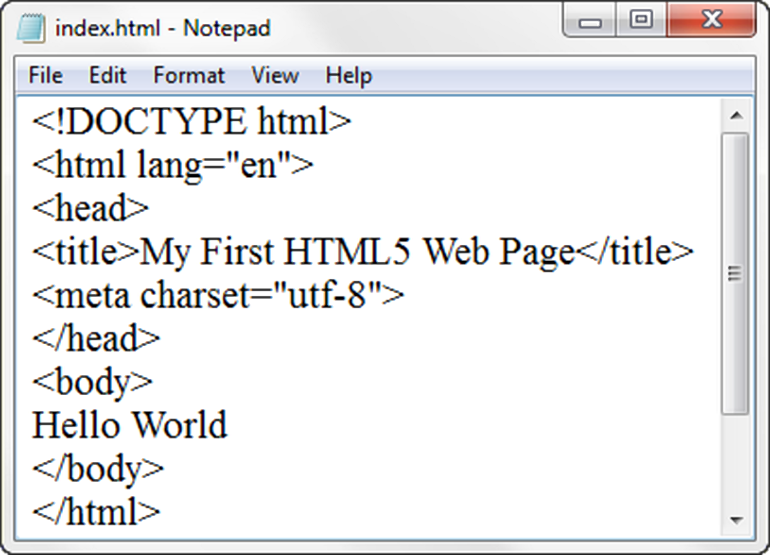
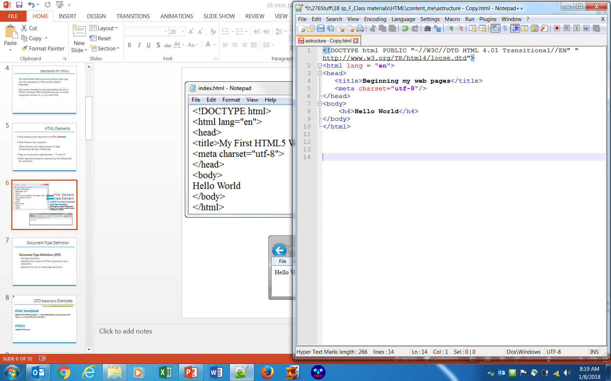
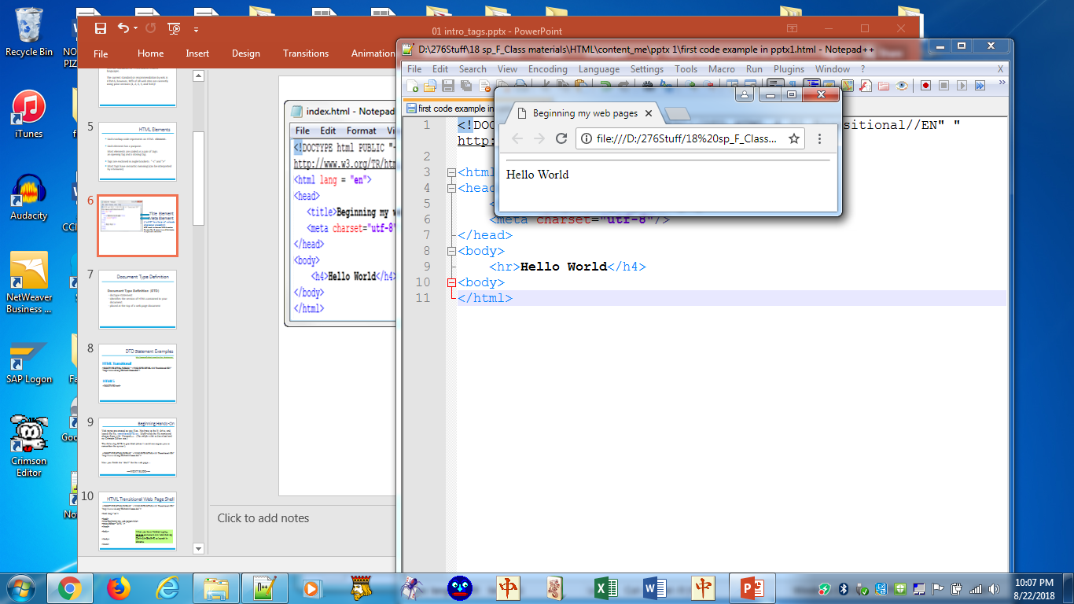
Title Element Meta Element
(“utf-8” is a form of unicode character encoding)
UTF stands for Unicode Transformation Format. The '8' means it uses 8-bit blocks to represent a character.

Slide 7
Document Type Definition
Document Type Definition (DTD)
doctype statement
identifies the version of HTML contained in your document.
placed at the top of a web page document

Slide 8
DTD Statement Examples
http://www.w3schools.com/tags/tag_doctype.asp
HTML Transitional
<!DOCTYPE HTML PUBLIC "-//W3C//DTD HTML 4.01 Transitional//EN"
"http://www.w3.org/TR/html4/loose.dtd">
HTML5
<!DOCTYPE html>

Slide 9
Beginning Hands-On
Web pages are created as text files. In the zipped file on BB, locate the file, transitionalDTD.txt. Right-click the file name and choose Open with Notepad++ . (You might wish to download and try Crimson Editor, too.)
The following DTD is provided (since I would not expect you to remember the syntax!)
<!DOCTYPE HTML PUBLIC "-//W3C//DTD HTML 4.01 Transitional//EN"
"http://www.w3.org/TR/html4/loose.dtd">
Now you finish the “shell” for the web page as shown on the next slide…
----NEXT SLIDE----

Slide 10
HTML Transitional Web Page Shell
<!DOCTYPE HTML PUBLIC "-//W3C//DTD HTML 4.01 Transitional//EN"
"http://www.w3.org/TR/html4/loose.dtd">
<html lang="en">
<head>
<title>Placeholder… will need to change</title>
<meta charset="utf-8“ />
</head>
<body>
Another placeholder…
</body>
</html>
When you have finished typing, save as astructure.html and then tap Ctrl-Alt-Shift-R to launch in Chrome or use Run… from the menu

Slide 11
HTML Tags
There are two types of tags in HTML: container tags and empty tags.
A container tag has both an opening and a closing tag and is used to surround the text within a document for presentation by the tag. The closing tag name is preceded by a forward slash.
<title>Beginning of my web page</title>
An Empty tag uses only an opening tag and tells the browser to perform an instruction, such as breaking to the next line, inserting a horizontal line, or inserting an image. An empty tag does not have a separate closing tag but should be closed with an internal slash. A space follows the last character of the tag name and precedes the slash. (The space and slash conform to XHTML standards.)
<br /> <hr />

Slide 12
Paragraph Element
Paragraph element
<p> …paragraph goes here… </p>
Groups sentences and sections of text together.
Block Display – Configures empty space above and below and occupies the full width of available space
Browsers read tags; they do not acknowledge other types of formatting such as tabs, indents, bullets, and extra spaces (unless identified with a tag).
Notes:
Tags have semantic meaning to browsers.

Slide 13
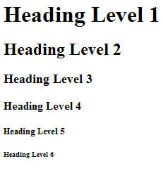
Heading Element
Browsers usually use Times NR 16px as default. h levels are proportional to the current font.
200%
175%
150%
100%
70%
50%
<h1>Heading Level 1</h1>
<h2>Heading Level 2</h2>
<h3>Heading Level 3</h3>
<h4>Heading Level 4</h4>
<h5>Heading Level 5</h5>
<h6>Heading Level 6</h6>

Slide 14
Line Break Element
Line Break element
Stand-alone, or empty tag
…text goes here <br /> This starts on a new line….
Causes the next element or text to display on a new line

Slide 15
Blockquote Element
Blockquote element
Indents a block of text for special emphasis
<blockquote>
…text goes here…
</blockquote>
Block Display – Configures empty space above and below

Slide 16
Try It Out
Open widgets1.html and parag.txt in Notepad++
Copy/paste the text from parag into the body section of widgets.
Save & view, noting that there are no paragraph or line breaks.
----
Add paragraph tags, heading tags, and blockquote tags as shown
----NEXT SLIDE----
When finished adding the tags, save and view in Chrome.

Slide 17
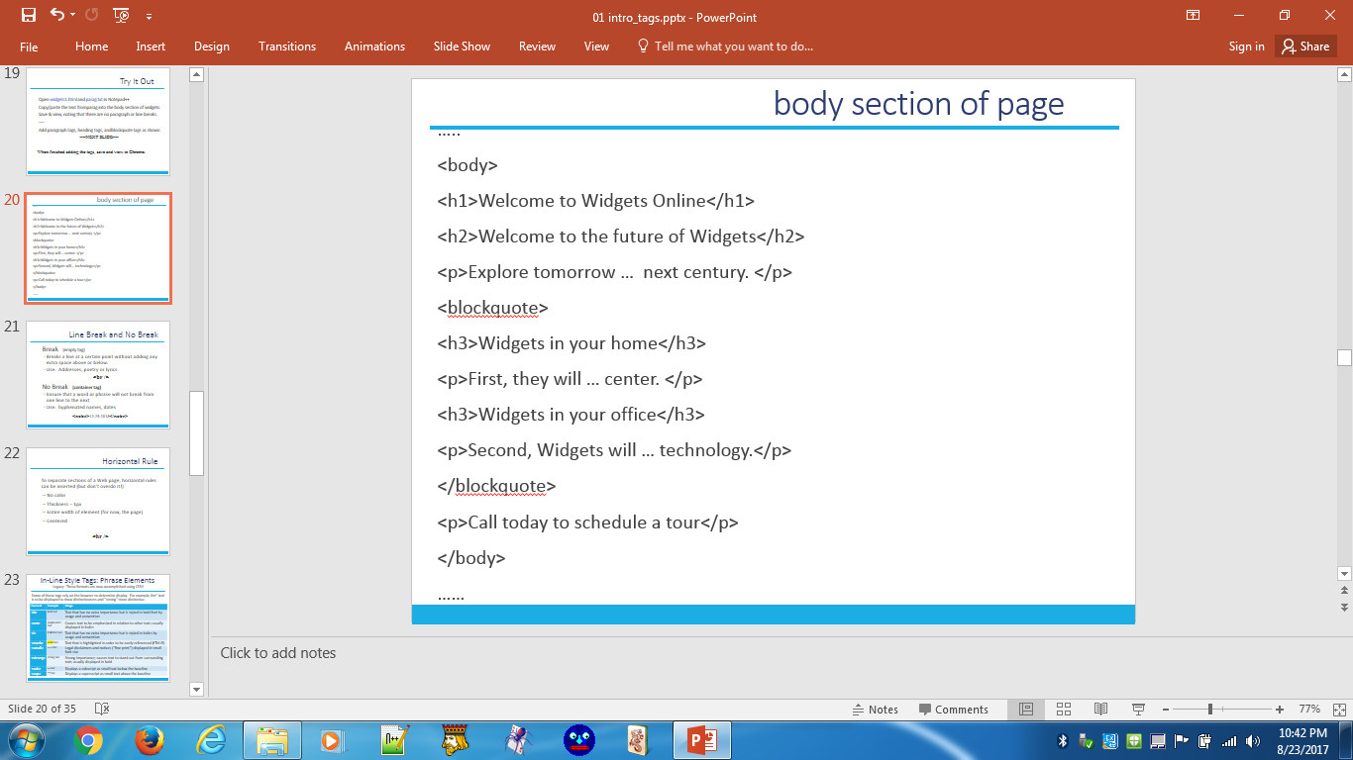
body section of page

Slide 18
Line Break and No Break
Break (empty tag)
Breaks a line at a certain point without adding any extra space above or below.
Use: Addresses, poetry or lyrics
<br />
No Break (container tag)
Ensure that a word or phrase will not break from one line to the next
Use: hyphenated names, dates
<nobr>12-25-2018</nobr>

Slide 19
Horizontal Rule
To separate sections of a Web page, horizontal rules can be inserted (but don’t overdo it!)
-- No color (black)
-- Thickness = 1px
-- Entire width of element (for now, the page)
-- Centered
<hr />

Slide 20
In-Line Style Tags: Phrase Elements
Legacy: These formats are now accomplished using CSS!!
In-line style tags should NOT be used for web site development in this class!
But you should be aware of them since you may see them in existing sites.
Element | Example | Usage
<b> | bold text | Text that has no extra importance but is styled in bold font by usage and convention
<em> | emphasized text | Causes text to be emphasized in relation to other text; usually displayed in italics
<i> | italicized text | Text that has no extra importance but is styled in italics by usage and convention
<mark> | mark text | Text that is highlighted in order to be easily referenced (HTML5)
<small> | small text | Legal disclaimers and notices (“fine print”) displayed in small font-size
<strong> | strong text | Strong importance; causes text to stand out from surrounding text; usually displayed in bold
<sub> | _{sub} text | Displays a subscript as small text below the baseline
<sup> | ^{sup} text | Displays a superscript as small text above the baseline
Notes:
em will take on a different meaning when we get to CSS.

Slide 21
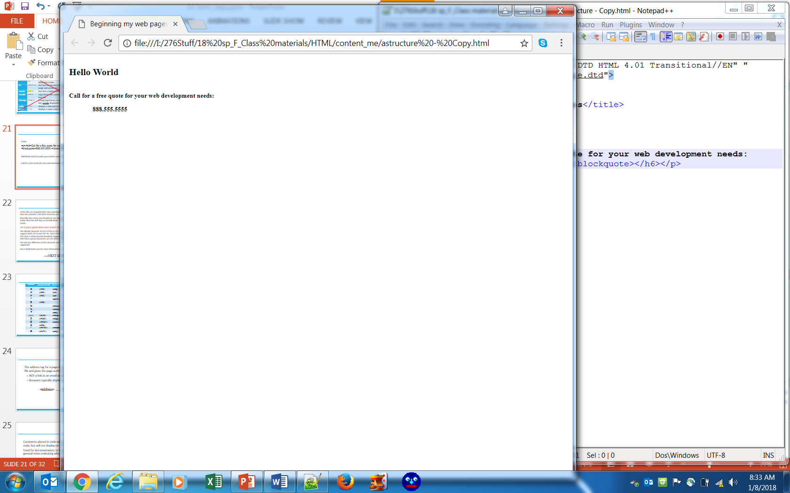
Proper Nesting
CODE:
<p><h6>Call for a free quote for your web development needs: <blockquote>888.555.5555 </blockquote></h6></p>
BROWSER DISPLAY (with space before and after since it is a paragraph):

Slide 22
Character Sets
HTML files are standard ASCII text and should contain no special characters other than the standard 8-bit ASCII character set.
Basically, this means you should not use any characters that require any key (other than the shift key) to be held down. This would include bullets or accent marks.
TIP: If your application uses Smart Quote, turn it off!
The default character set for HTML5 is UTF-8, and all HTML5 and XML processors support both UTF-8 and UTF-16. (UTF stands for Unicode Transformation Format. The '8' means it uses 8-bit blocks to represent a character.) Most HTML browsers use the code from the ISO-Latin-1 (International Standards Organization) character set, but bear in mind that these special characters are not 100% reliable across all platforms/browsers.
The primary difference in the character sets is the number of characters supported.
Go to W3Schools.com for more information and additional characters.
----NEXT SLIDE----

Slide 23
Character Codes
Character | Numbered Entity | Named Entity | Descripton
& | &#38; | &amp; | Ampersand
< | &#60; | &lt; | Less than
> | &#62; | &gt; | Greater than
" |  | &quot; | Double quote
# | &#35; |  | Number, hash, pound sign
¼ |  | &frac14; | One quarter
½ |  | &frac12; | One half
° |  | &deg; | Degree
(space) | &#160; | &nbsp; | Non-breaking space
@ | &#169; | &copy; | Copyright
€ | &#8364; | &euro; | Euro
$ | &#36; |  | Dollar sign
™ | &#8482; | &trade; | Trademark
® | &#174; | &reg; | Registered sign
http://www.w3schools.com/

Slide 24
Address
The address tag for a page is usually the last item in a file and gives the page author and email address:
-- NOT a link to an email address
-- Browsers typically display in italics
<address> … </address>

Slide 25
Comments
Comments placed in code will show in the source code, but will not display on the Web page itself.
Used for documentation, to indicate web author, as general notes indicating what the code is doing, etc.
<!-- comments -->

Slide 26
Exercise 1a (or see Instruction file in folder)
Create a file structure for your first project: A folder with the project name (universal) and three folders in the project folder (images, pages, styles).
Open astructure.html in Notepad++ and save it as universal.html (in your project folder) and open universal.txt to copy/paste text.
In the head area add the title Universal Box.
For the body text…
Make "Universal Box Company" a heading 1.
"Message from Our President, Jane Xavier" should be a heading 2.
The quote by Sam Xavier should be indented from both sides of the page.
Make the informational statement and email addresses an address, displayed on 4 lines.
Add a comment in the header area that identifies who created the Web page and the date created.
--NEXT SLIDE----

Slide 27
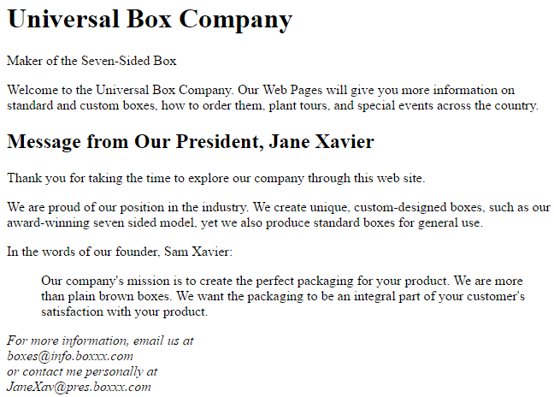
ex 1a finished

Slide 28
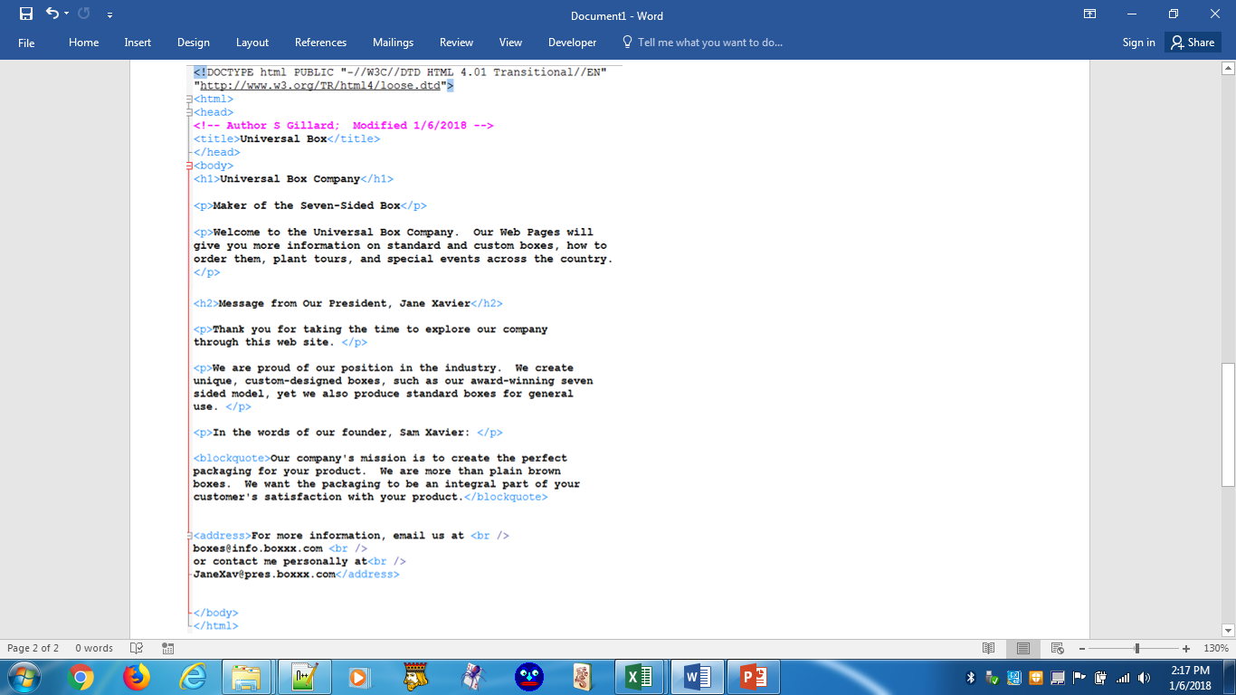
ex 1a code

Slide 29
Exercise 1b (or see Instruction file in folder)
Open universal.html (ex 1a completed) and order.txt in Notepad++
Copy/paste order.txt text immediately before the address in universal.html.
Insert a solid line above and below the material you just pasted.
"How to Order" should look like "Message from our President…"
Add tags to the remaining new text to make it look like the finished illustration provided.
Find the motto ("Maker of the Seven-Sided Box") and apply an h level to render as shown.
Place the sentence "Welcome to the Universal Box Company" on a line of its own (make it a paragraph).
Add a registered trademark symbol after the company name.

Slide 30
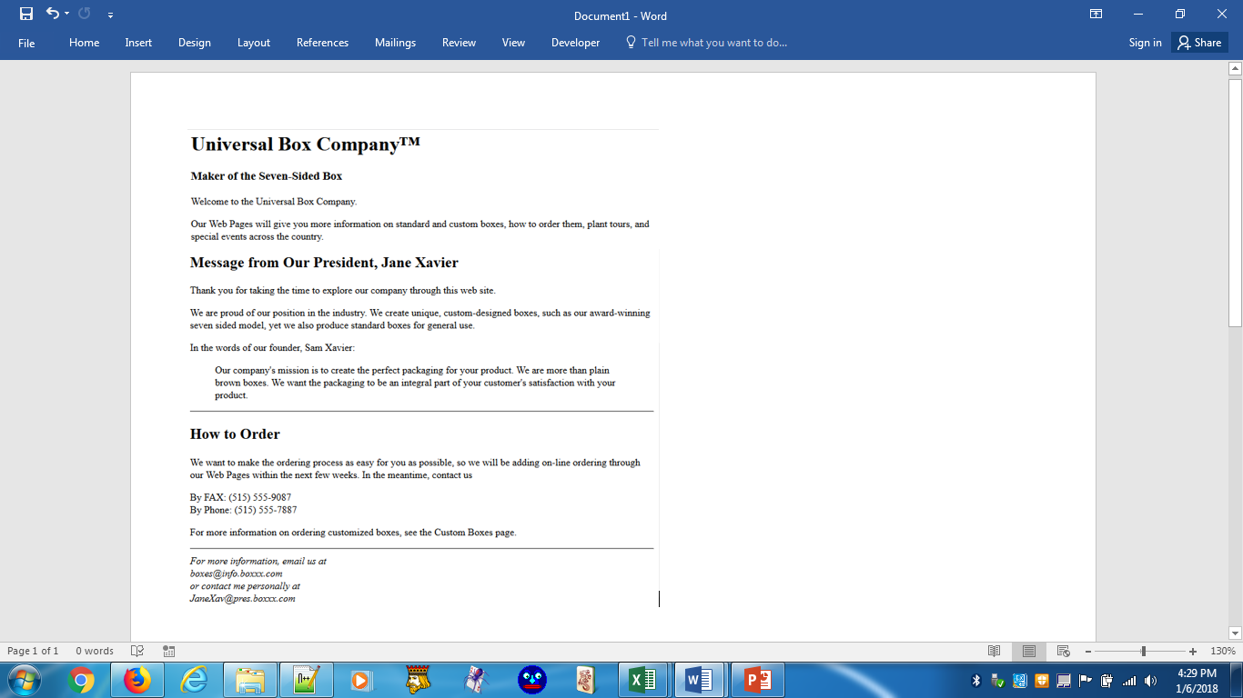
ex 1b finished

Slide 31
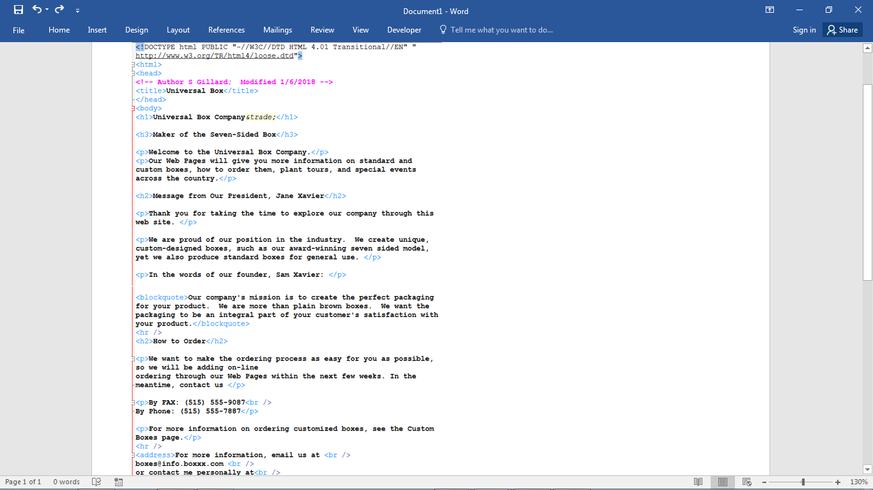
ex 1b code

Slide 32
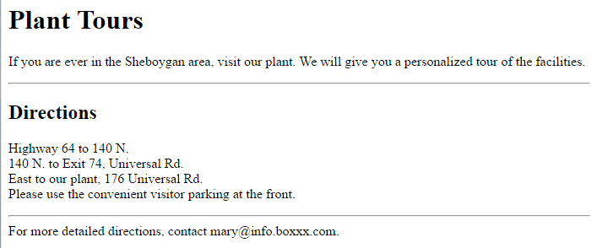
Exercise 1c (or see Instruction file in folder)
Create a new page entitled Plant Tours. For the text, use the text file tours.txt. After editing the page, save as tours.html.
Make the text Plant Tours a Heading 1. Make Directions a Heading 2. Use line breaks for the direction information. Insert horizontal lines as shown.

